Slide 1
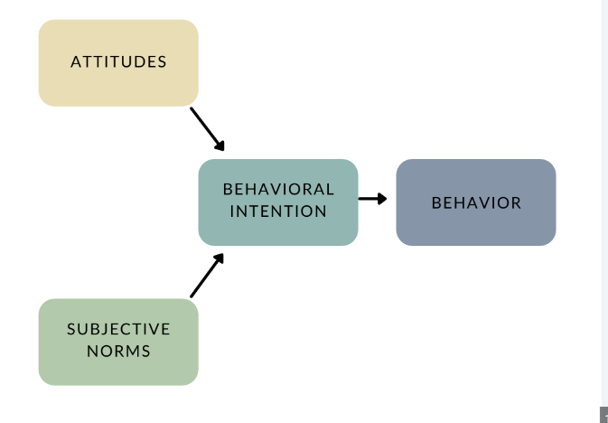
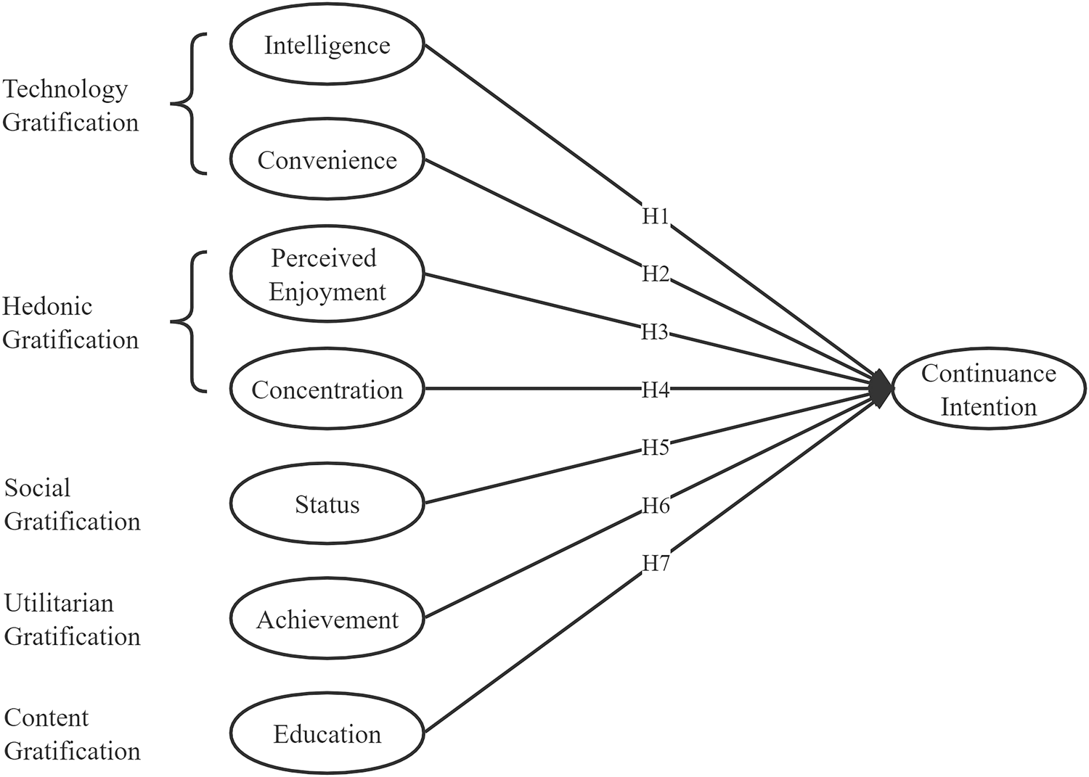










Theory Of Reasoned Action
An individual's intention to perform a behavior is determined by their attitudes toward the behavior and subjective norms. This intention, in turn, predicts the likelihood of the individual actually engaging in the behavior.
Behavioral Intention: an individual's readiness or willingness to engage in the behavior is influenced by:-
Attitudes: Individuals' beliefs about the outcomes of the behavior. Positive attitudes increase the likelihood of performing the behavior.
Subjective Norms: Perceived social pressure or influence from others regarding the behavior. Like approval or disapproval from significant others.
User Gratification theory
It posits that users seek gratification from their interactions with technology and media. The core idea is to leverage elements like points, badges, leaderboards, challenges, and rewards to make tasks or activities more enjoyable, interactive, and rewarding for users.
Satisfaction from features, functionalities of tech. like HD camera, high speed, good UI/UX
Entertainment and relaxation like watching insta reels
Users seek social interaction & validation thru tech.
Fulfill needs with help of tech like solving problems, productivity apps, navigation apps
Relevance, credibility, novelty, diversity of content like news, articles, edu. videos

Slide 2
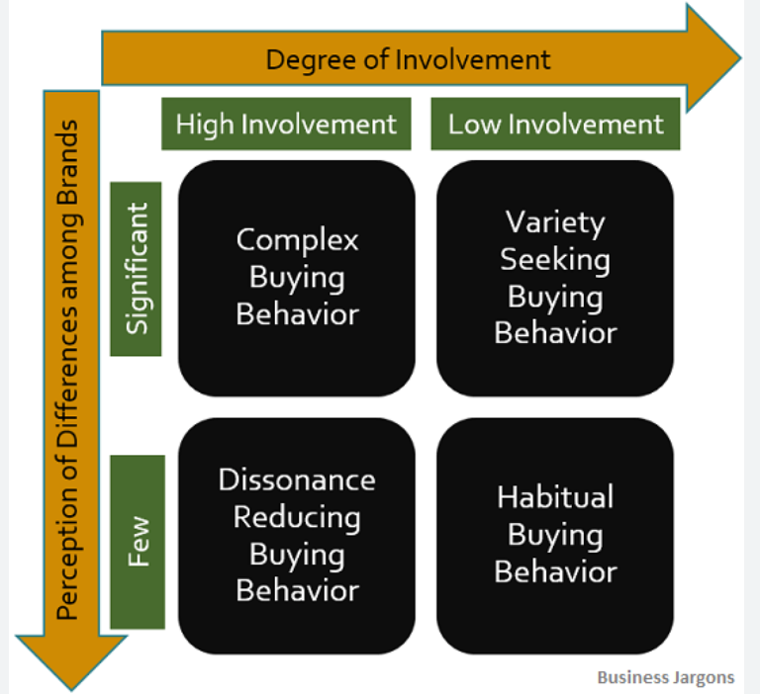
TYPES OF CONSUMER BEHAVIOR

Slide 3
Complex Buying behaviour: high involvement (expensive products like house, car) and perceived high risk. Consumers engage in extensive research and comparison before making a purchase. In addition, it is necessary to create specific advertising messages (quality, safety features, prestige) that influences the buyer’s beliefs as well as attitudes. Ex: Mercedes-Benz
Dissonance-reducing consumer behaviour: buyer is highly involved, perceived low risk but sees little difference between the various brands like TV, smartphone. After having bought a product, the consumer is likely to experience the dissonance (noticing that other brands would have been just as good, if not better). The main feature here will be the use and the budget. Marketers should focus sale campaigns & building repeated purchases. Ex: Apple
Variety seeking buying behavior: Low involvement but high perceived risk (consumer is always looking for something new and different) like food, cosmetics. In this case, consumers often do a lot of brand switching. One way is to create a product which has the same brand but different versions. Frequent advertising, offer lower prices, discounts, deals and free samples to attract potential customers. Ex: Maybelline, Rhode Beauty
Habitual buying behavior: Low involvement and low perceived risk like groceries, toiletries. Consumers purchase products out of habit without any thought or effort. Buyers either purchase their favorite brand, the one that they use regularly or the one available in the store (no brand loyalty). Marketers should particularly concentrate on visual symbols and images. Ex: Coca Cola

Slide 4
Psychological Drivers Of Luxury Consumption
Status and Social Comparison: The desire to fit in with a certain social group, or to stand out from others. It is a symbol of success and wealth.
Emotional Connection: a consumer may associate a luxury brand with happy memories from their childhood or with a special time in their life.
Identity and Self-Expression: Luxury goods and services can also be used as a form of self-expression, individualism, showcasing personal style and creativity.
High Quality and Long Lasting
Social Norms and Expectations
How To Attract & Retain Luxury Brand Consumer:
Personalised experience, Emotional connection , Quality, Exclusivity, Technology implementation, Online presence, Customer Service

Slide 5
DIFFERENT KINDS OF LUXURY CONSUMER
Traditionalists: History and quality reign supreme (Rolex).
Trendsetters: They crave the latest status symbols (Louis Vuitton).
Conscious Crowd: Sustainability and ethics are key (ethically-sourced diamonds).
Experimenters: Open to exploring different luxury brands (independent designers).
Investors: Luxury goods are seen as investments (jewellery, cars).
Discreet Buyers: Quality without flashy logos (Burberry).
Occasional Splurgers: Luxury for special moments (designer handbag).

Slide 6
TYPES OF MOBILE MARKETING
In-App Marketing: involves using banners, overlays, and inbox messages to promote products. Ads can be displayed on popular, widely used apps using banners, full-page ads, or videos.
SMS Marketing: You can send promotions, alerts, offers to customers using SMS. This strategy works because it is hard to ignore notifications.
Mobile Marketing Through Social Media
Location-Based Marketing
QR Code Mobile Marketing: lets you generate a link to your website, encourage app downloads, request business reviews, or prompt newsletter signups. Customers can easily scan the QR code using their smartphone cameras.

Slide 7
INFLUENCE OF MOBILE MARKETING ON CONSUMER BEHAVIOUR
1. Awareness: helps create brand awareness by reaching potential customers through targeted ads on social media platforms. By consistently appearing on screens, business becomes more familiar and recognizable to consumers.
2. Research: Consumers research products and services before making a purchase through mobile-optimised websites, product reviews, and comparison tools.
3. Personalization: Through data analytics, mobile marketing allows businesses to deliver personalized content and promotions that resonate with individual preferences and needs.
4. Location-based targeting: Marketing through mobile phones can utilize location-based services to deliver timely and relevant offers when consumers are near a physical store.
5. Ease of purchase: Mobile marketing simplifies the purchasing process by integrating seamless payment options and reducing friction.
6. Post-purchase engagement: businesses can send push notifications, follow-up emails, or in-app messages to maintain engagement, encourage repeat purchases, and solicit feedback

Slide 8
TRI COMPONENT ATTITUDE MODEL
Describes the effect of various external stimuli on the behaviour and attitude of individuals. The tri-component attitude model stipulates that attitudes comprise of three main components:
COGNITIVE: Thoughts, beliefs, and knowledge consumers hold about the attitude object. It's essentially the information we have accumulated through experience, advertising, word-of-the-mouth. Example: Someone who believes that electric cars are more environment friendly than traditional gasoline-powered cars may seek out information about the environmental impact of different types of vehicles
AFFECTIVE: Focuses on the emotions and feelings we associate with the attitude object. It an individual’s perception of positive or negative feelings generated by interactions with surroundings. Example: Watching fav sports team play can evoke strong positive emotions in a fan like excitement or pride.
CONATIVE: This component represents our behavioral intentions or tendencies to act (to buy or not to buy) with respect to the attitude object(product/service offering). It's about the likelihood that we will buy a product, recommend a service, or avoid something entirely. Example: A person who cares deeply about animal welfare (cognitive component) and feels strongly empathetic towards animals (affective component) may volunteer at an animal shelter, donate to animal rescue organizations, or adopt a vegetarian or vegan lifestyle.

Slide 9
BRAND COMMUNITY
A brand community is a collection of individuals who showcase brand loyalty by being emotionally invested in the brand. Not only are they regular customers but they are also advocates who tell their families, friends, coworkers about your brand.
1) Shared Consciousness: refers to the bond that individuals feel with a brand and with each other. Even without direct interaction, this connection fosters a sense of companionship and uniqueness among members. For example, Mac users, being a minority in a PC-dominated world, share a creative lifestyle and aesthetic appeal, leading to a feeling of belonging and specialness among brand users.
2) Rituals and Traditions: involve public greetings that recognize and acknowledge fellow brand users. For example, Harley owners share a special handshake that consolidates the brother-sisterhood of riders.
3) Moral Responsibility: Brand communities are further marked by a collective sense of moral responsibility to individual members as well as the community-as-a-whole. For example, within the outdoor enthusiast community, members may feel a responsibility to preserve natural habitats and promote sustainable practices. This shared moral responsibility further strengthens the cohesion and integrity of the brand community.

Slide 10
TYPES OF VIRTUAL STORES
The objective of virtual shopping platforms is to enable customers to interact and experience a product or service before making a purchase. It helps retailers create a digital storefront that replicates the experience of shopping in an offline store.
Virtual try-on: uses VR or AR technology to give shoppers an immersive experience of what the product looks like on them.
Virtual try-out: allows online shoppers to place virtual products in real world and see how the items look on a shelf.
Virtual search: allows shoppers to search for products using images instead of words.
360-degree product view: This store enables shoppers to see a product in the virtual store from all angles.
Video interactions store: This store offers one-on-one virtual consultations through video chats or chat features with clients to build credibility and trust.
SHOPPER EXPERIENCE IN VIRTUAL STORE
Lower your website’s load time
Upload high-quality product images
Post customer reviews
Live chat experience
Simple checkout process

Slide 11
HOW VIRTUAL STORES HELP RETAILERS
Brand loyalty: Data obtained from the shopper’s behavioral analysis helps determine their product preferences.
Basket size: Analyzing the number of products purchased by shoppers in a single transaction helps retailers identify the products or promotions that effectively drive their sales.
Conversion rates analysis: Conversion rate is the percentage of new clients who make purchases after visiting the store.
Foot traffic: This data shows the area of the store that gets more visitors and the customers’ product preferences.
Options

Slide 12
INDIAN RETAILERS USING AI/VR TO ENGAGE CUSTOMERS
RENT IT BAE
- Show & Pop: Smart screens provide detailed product information when items are placed in front of them.
Talk to the Store: Voice-enabled service allows customers to voice preferences and receive recommendations.
Wear and Share: Customers can record 360-degree views of outfits for easy comparison and share videos for feedback through the RENT IT BAE app.
Tanishq, a prominent jewellery retailer introduced augmented reality (AR) kiosks at airports featuring VR-enabled technology called 'MirrAR,' allowing customers to virtually try out jewellery multiple times.
Lenskart offers a virtual trial service using 3D face modeling technology, allowing users to virtually try on frames. The technology measures the user's face from various angles and enables them to view the glasses from different perspectives by swiping on the image. This online trial makes frame selection faster, more effective, and enjoyable by leveraging preferences and historical data.
Nykaa, a popular online beauty and cosmetics retailer in India, leverages AI-powered beauty tools to offer personalized skincare and makeup recommendations to customers. Their "Virtual Try-On" feature allows users to experiment with different makeup looks virtually using their own photos or live camera feed.

